Slide 1
USAID Zambia Evidence For Health (E4H)
PRESENTATION ON SELECTED MALARIA related INDICATORS - DHIS2 data
Zambia Evidence for Health Project
April, 2022
Notes:
Purpose: To assess the performance of the Malaria program in Zambia as part of annual PMI process with each IP
Audience: PMI

Slide 2
Malaria Confirmed Cases Trends

Slide 3
National Malaria Cases Yearly Trends -2016 to 2021
Notes:
Make sure the presenter can summarise the general pattern

Slide 4
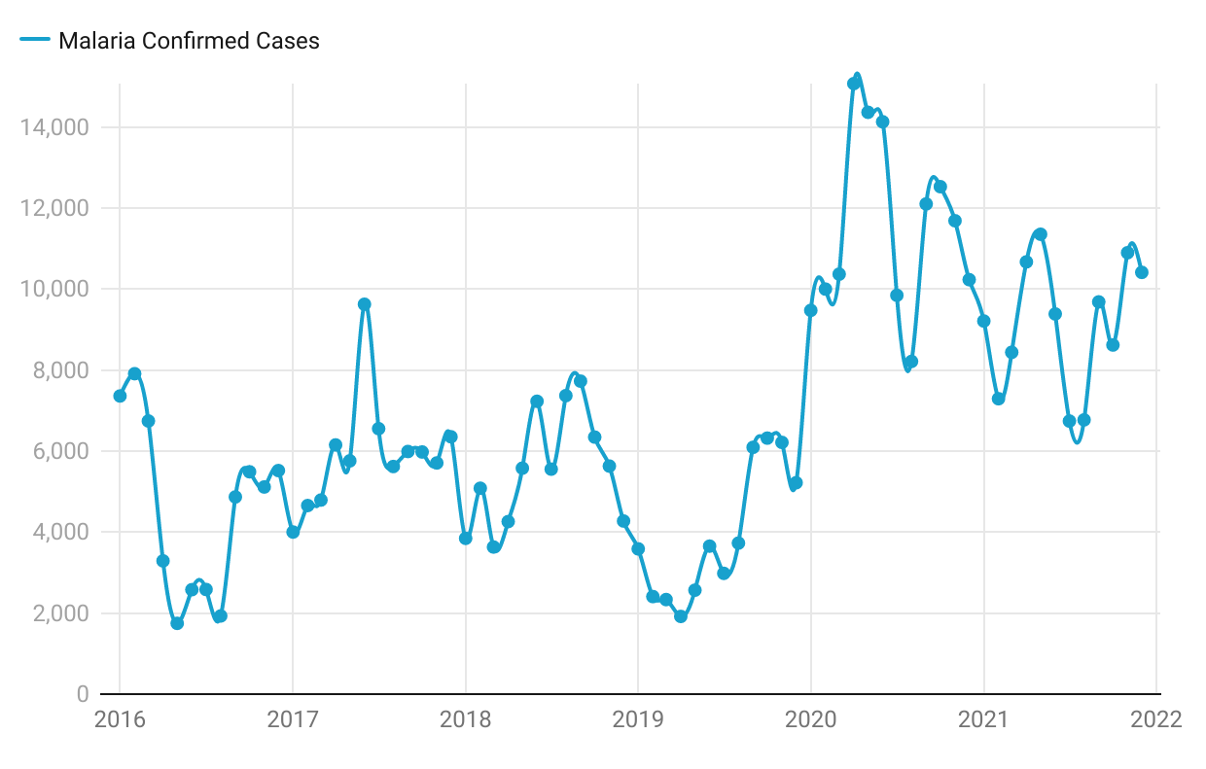
Nchelenge Malaria Cases Monthly Trends -2016 to 2021
Notes:
This is striking—looks like a shift in 2020. It makes me wonder if the change in 2020 had anything to do with changes that came about from the COVID-19 pandemic
You may consider doing a formal run chart analysis here (I will share an NHS guide that has some simple directions for analysis on pages 26-28)

Slide 5
Nchelenge Malaria Cases Yearly Trends -2016 to 2021
Notes:
I would suggest keeping just one legend explaining the different colours in one place rather than six legends explaining one colour each. The audience will understand more quickly if they see the legend in one place
Since there is no summary of what the interpretation is here, make sure the presenter can describe clearly and simply what the pattern is

Slide 6
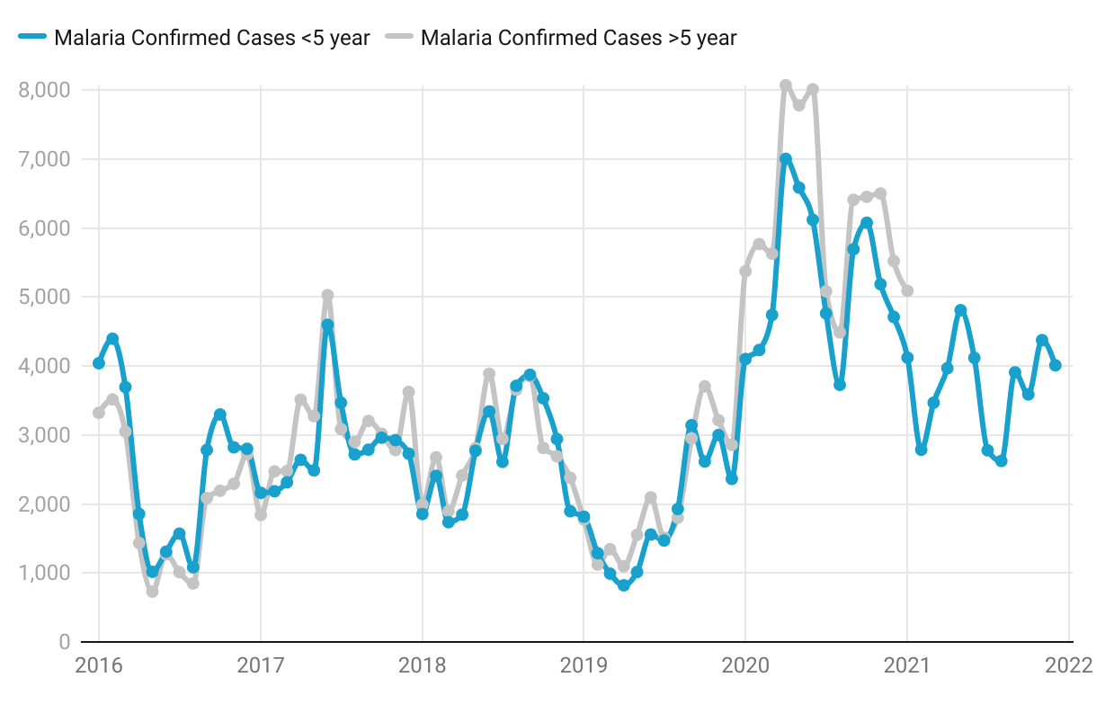
Nchelenge Malaria Cases Monthly Trends (Age Groups) -2016 to 2021
Notes:
I would suggest a more visible colour for >5
It’s so interesting that the number of cases is similar between the two age groups. I wonder what the population of the two groups might be (ie whether the rate among each age group is similar)

Slide 7
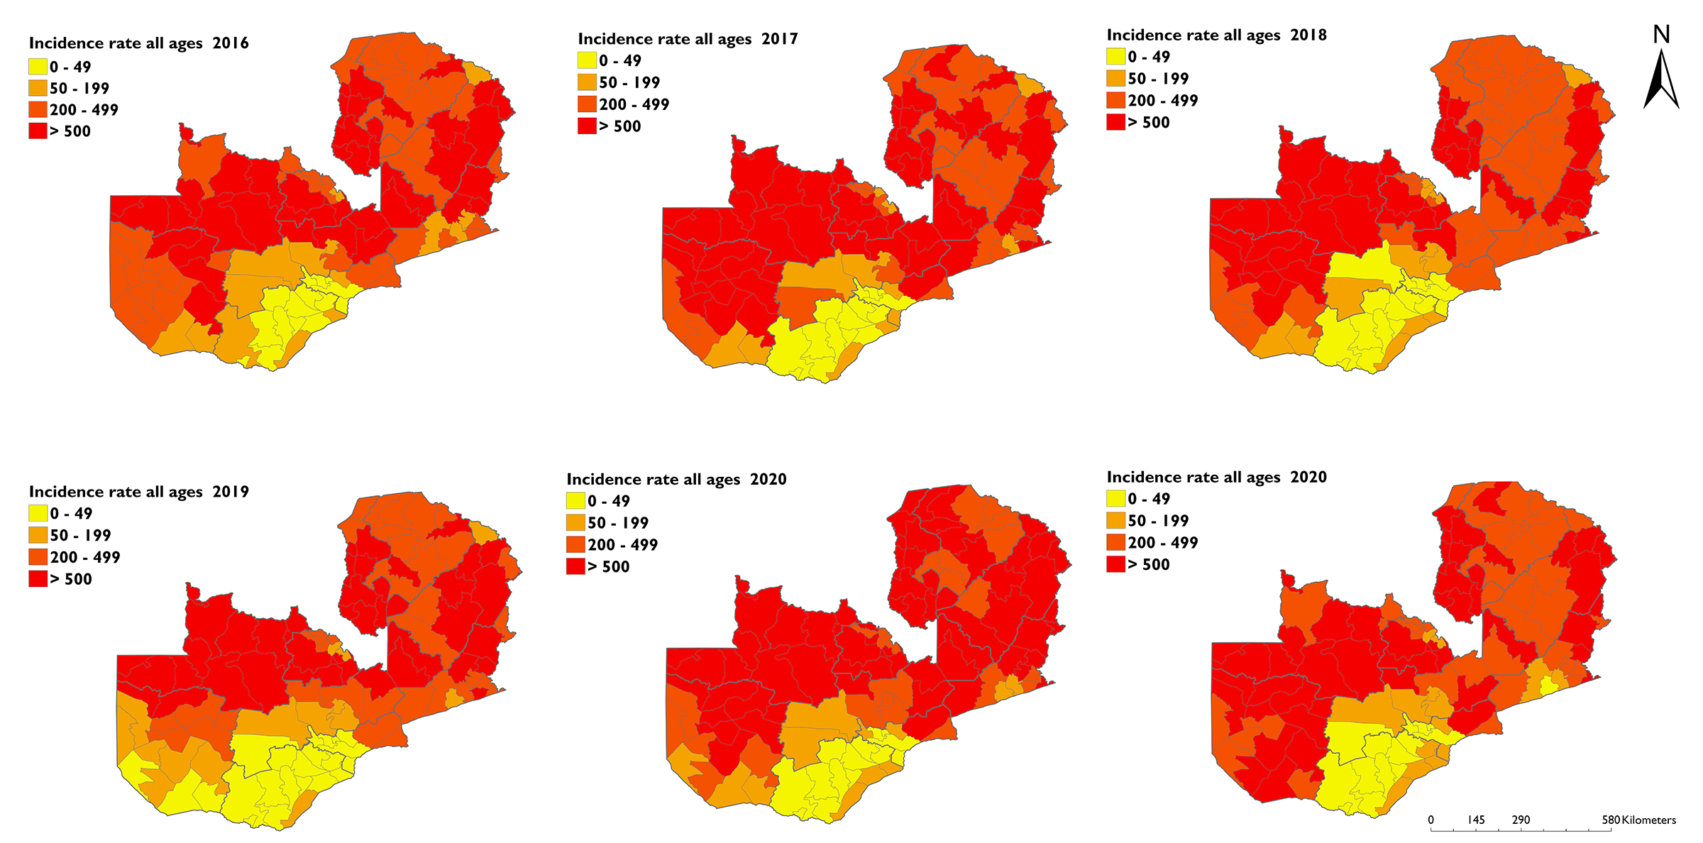
Districts Malaria Incidence Rates Trends -2016 to 2021
Notes:
It’s difficult to see what the pattern might be.
If you are not able to describe the pattern, what is the purpose of presenting this? If you are inviting your audience to help interpret, say this during the presentation

Slide 8
Nchelenge Malaria Incidence Rates Trends -2016 to 2021

Slide 9
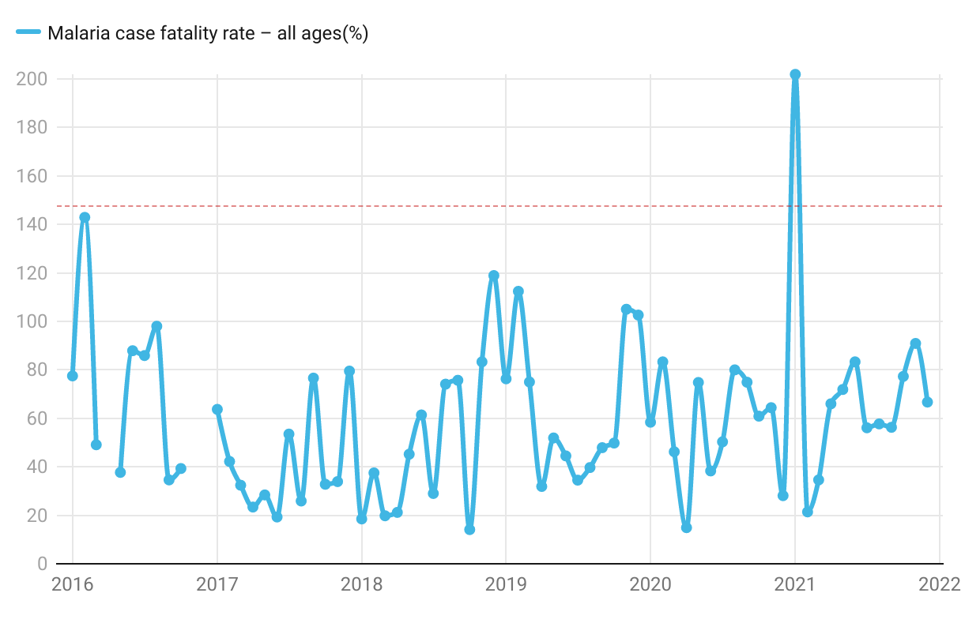
Nchelenge Malaria case fatality rate all ages-2016 to 2021
Notes:
I would suggest limiting this to <5s as this I where mortality is typically greater. Unless this is not the case with these data (so you could also separate by age)

Slide 10
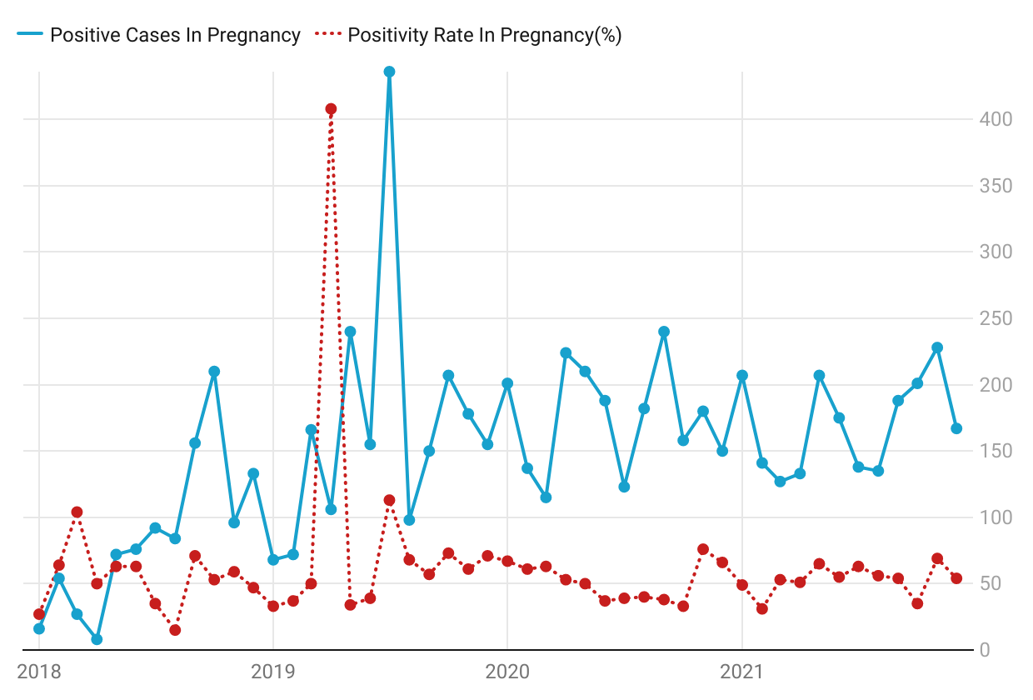
Nchelenge Malaria Positive cases in Pregnant Women-2016 to 2021
Notes:
Can you explain the outlier? Is it an artifact of data quality? What happened to the denominator, did it drop for some reason?

Slide 11
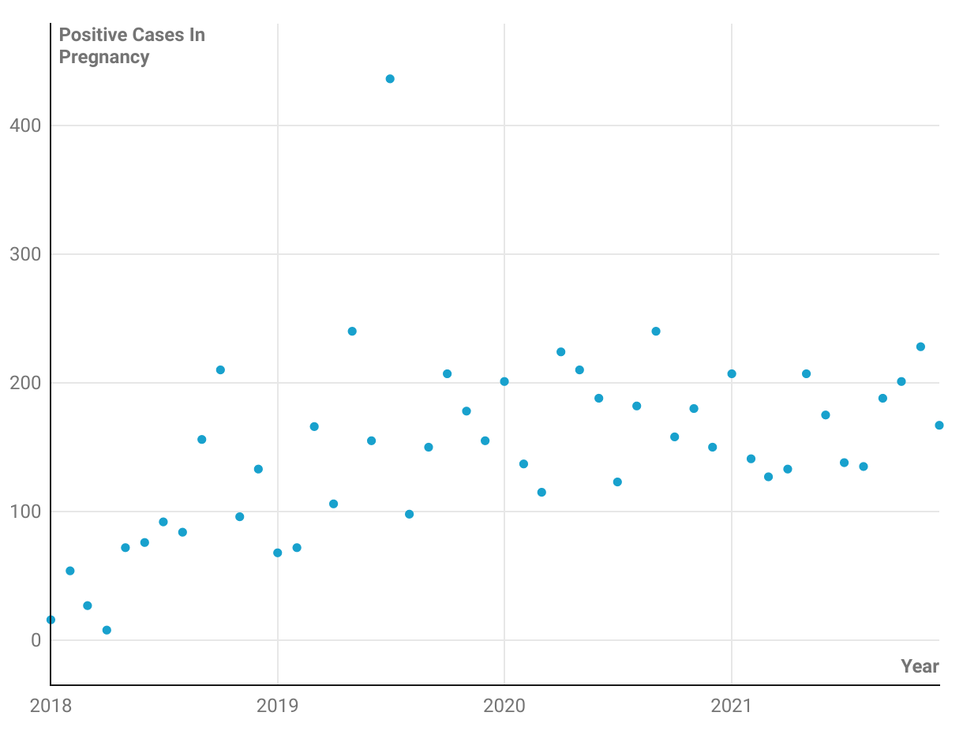
Nchelenge Malaria Positive cases in Pregnant Women-2018 to 2021
Notes:
I would suggest a line graph, perhaps with a best fit line
For analysis also graph the denominator to make sure it is relatively constant. If it is, you can leave it out

Slide 12
Malaria Deaths

Slide 13
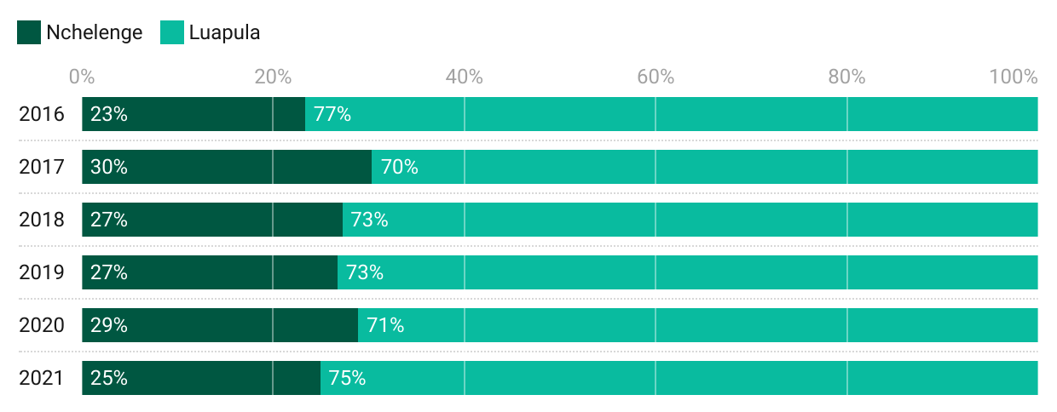
Nchelenge District Malaria Deaths Contribution in Luapula Province - 2016 to 2021
Notes:
Why do you call these deaths and present percentages, whereas you labeled slide # 9 as case fatality rates? What is the difference?
Why are we focused on Nchelenge in Luapula?
Is Nchelenge the highest contributor to Luapula province totals? If so, I would suggest including this in the title

Slide 14
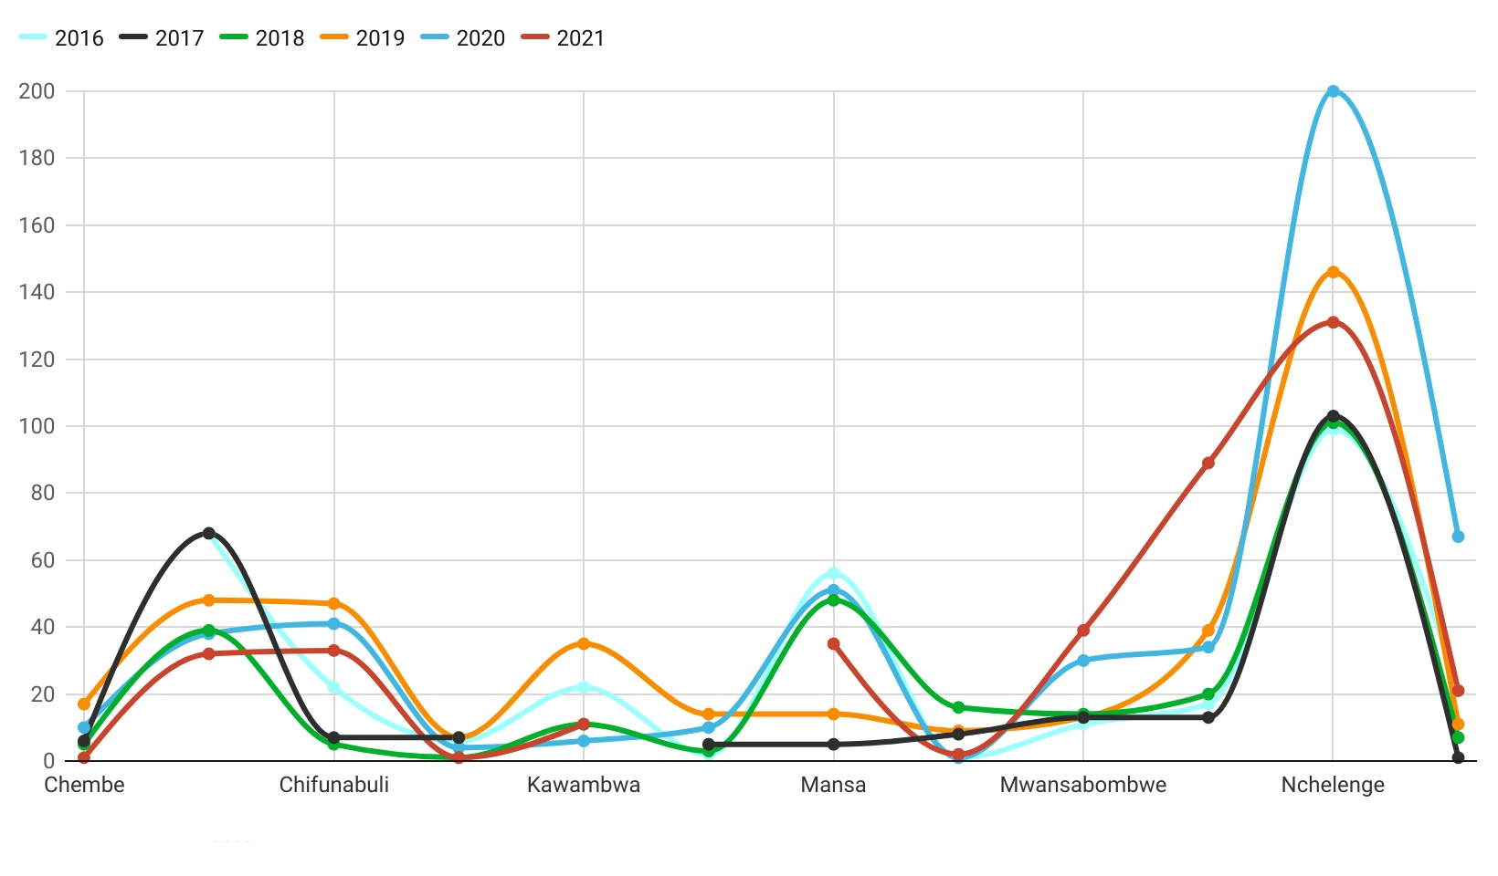
Luapula Districts Malaria Deaths Trends - 2016 to 2021
Notes:
The colours do not communicate which years are more recent. Can you select a colour scheme that goes from lightest to darkest so that it intuitively communicates chronologic order? For instance from shades of yellow, shades of orange to shades of red? Another possibility would be to make the black line the most recent year because it stands out and is clearest.

Slide 15
Districts Malaria Deaths in Luapula Province - 2016 to 2021
Notes:
What is the pattern here, can you describe it in one sentence? This is just a question for the presenter
Again I suggest one legend for all six figures

Slide 16
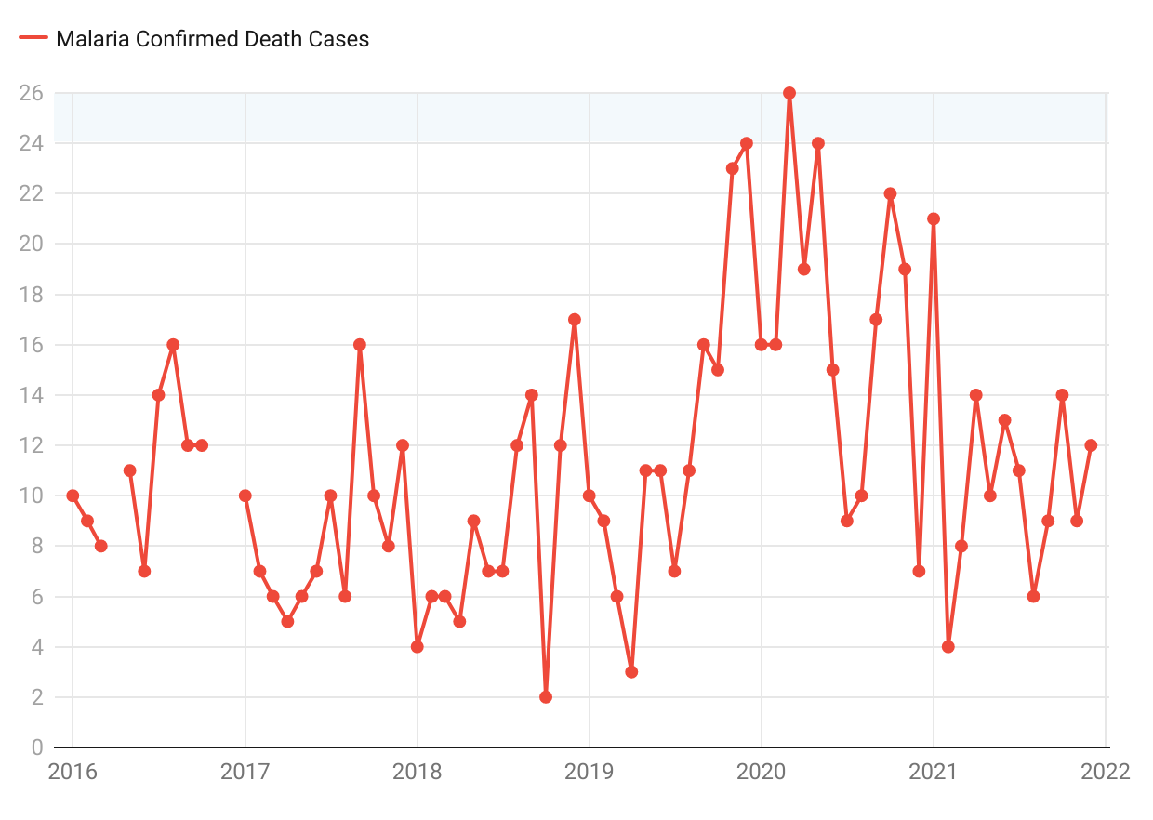
Nchelenge Malaria Deaths Trends - 2016 to 2021
Notes:
How is this different from #9?
Shouldn’t all Nchelenge Malaria slides be presented together (ie in consecutive slides)?

Slide 17
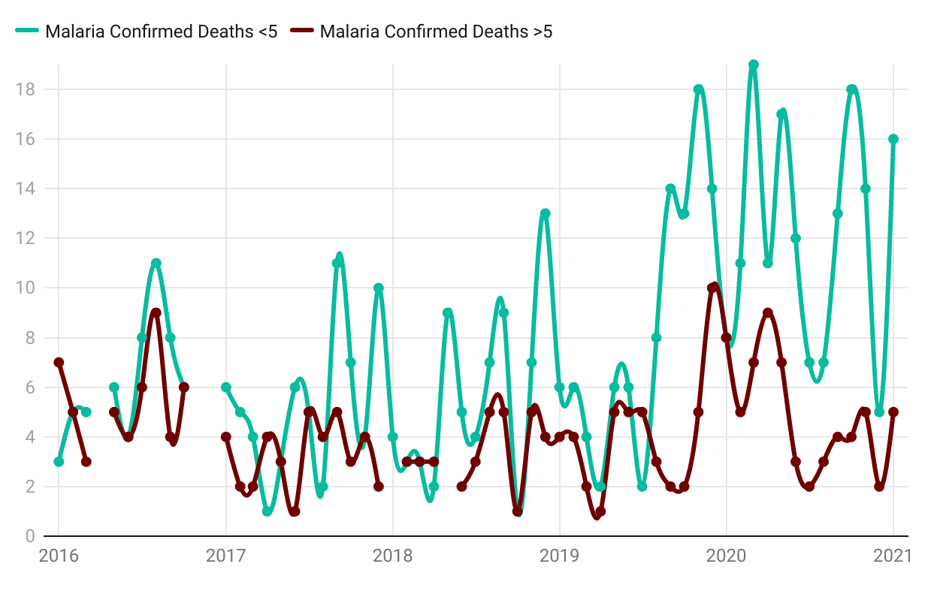
Nchelenge Malaria Deaths Trend (Age groups) 2016 to 2021
Notes:
This should be presented right after #6 so people can see that while the number of cases is not so different, the case fatality falls on the <5s

Slide 18
Severe Malaria

Slide 19
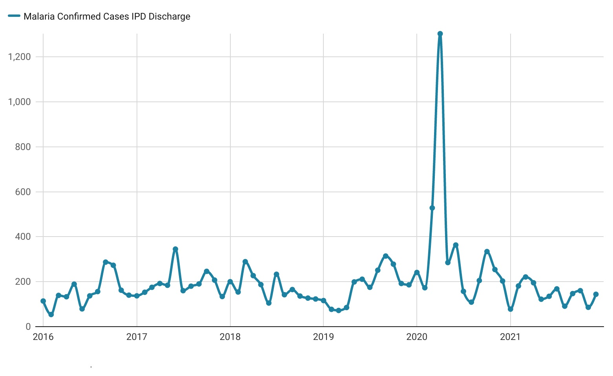
Nchelenge Total Malaria Admissions Monthly Trends 2016 - 2021
Notes:
what happened to cause the spike in the first half (April?) of 2020? Does this include the part of the health system receiving refugees?

Slide 20
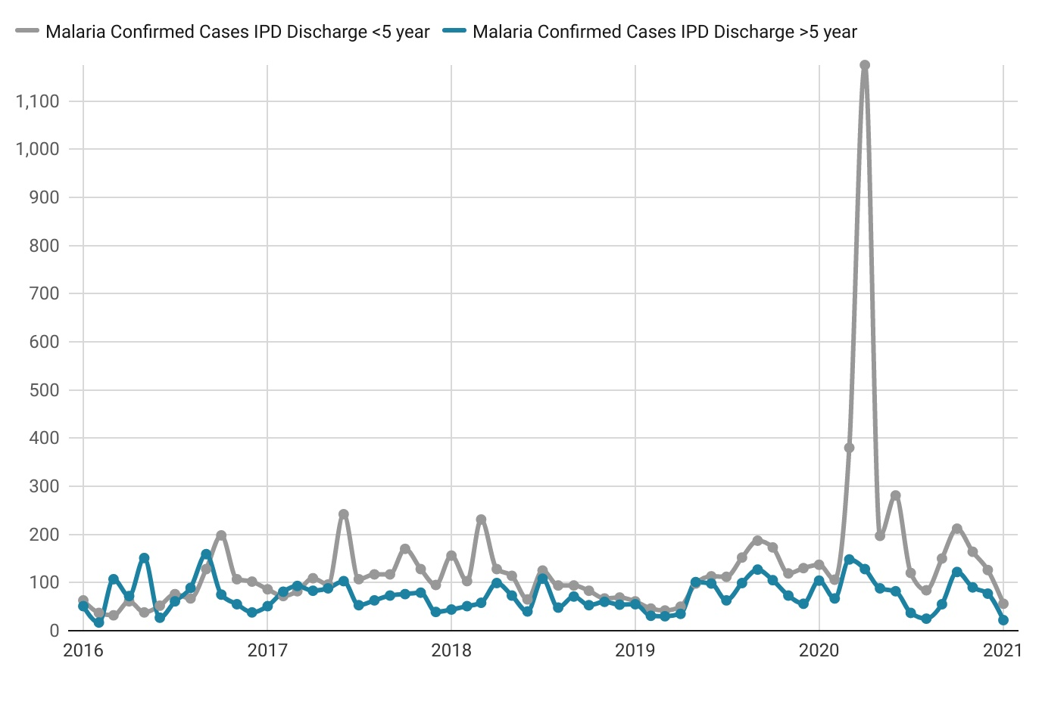
Nchelenge Total Malaria Admissions Monthly Trends (Age group) 2016 - 2021

Slide 21
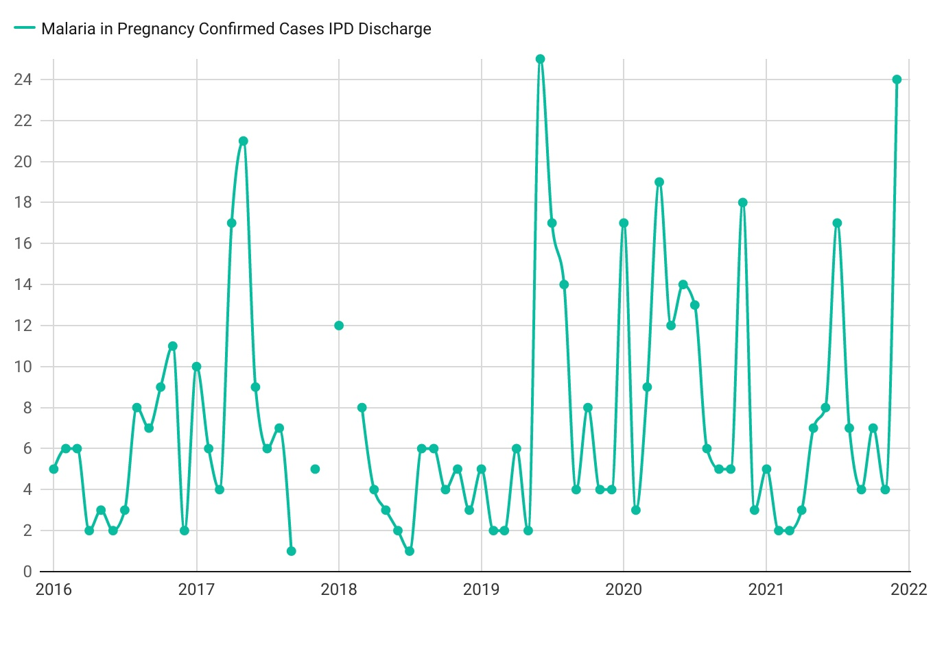
Nchelenge Malaria Admissions In Pregnancy 2016 - 2021
Notes:
Why are some points disconnected and others connected?

Slide 22
IRS Coverage, OTTS & Commodities
Notes:
Write out outreach training and supportive supervision

Slide 23
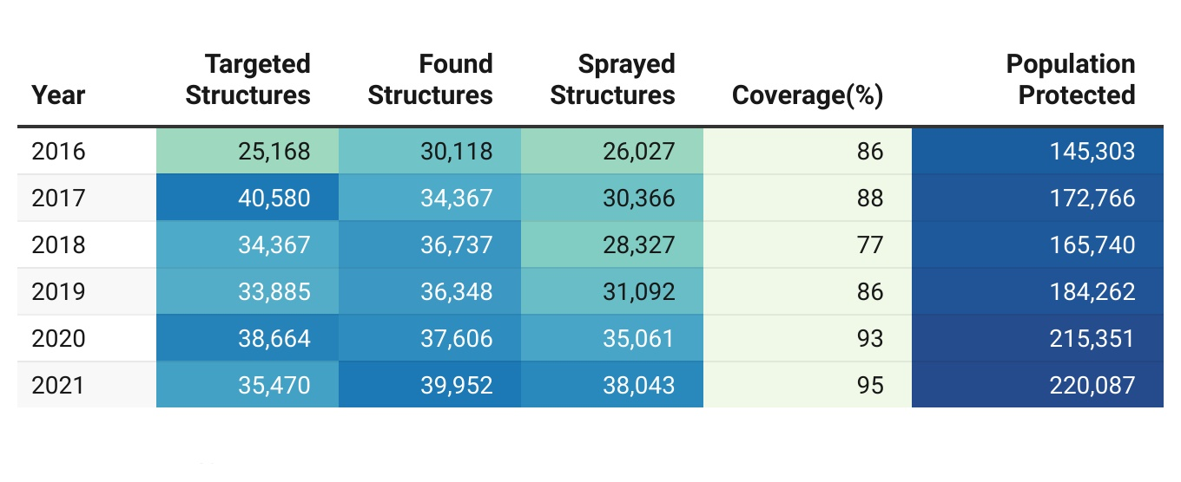
Nchelenge IRS Coverage from 2016 to 2021
Notes:
Was the same insecticide used each year? Same structures?

Slide 24
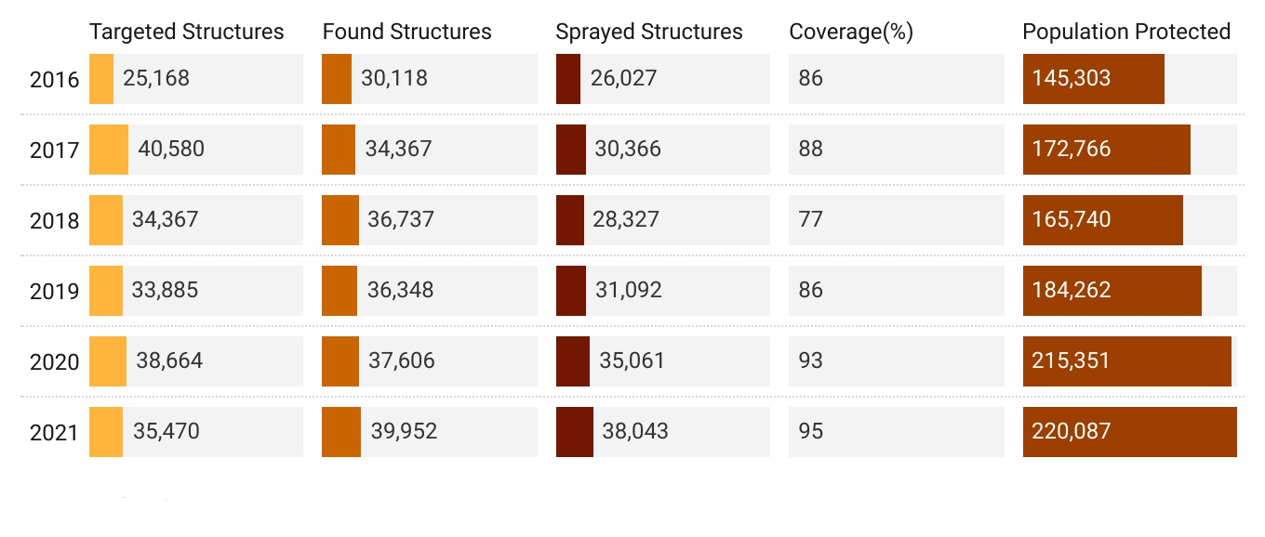
Nchelenge IRS Coverage from 2016 to 2021
Notes:
So the story here is the increase in coverage? If so consider editing the title to reflect this conclusion. The same could be done with other slides—present the conclusion in title when possible

Slide 25
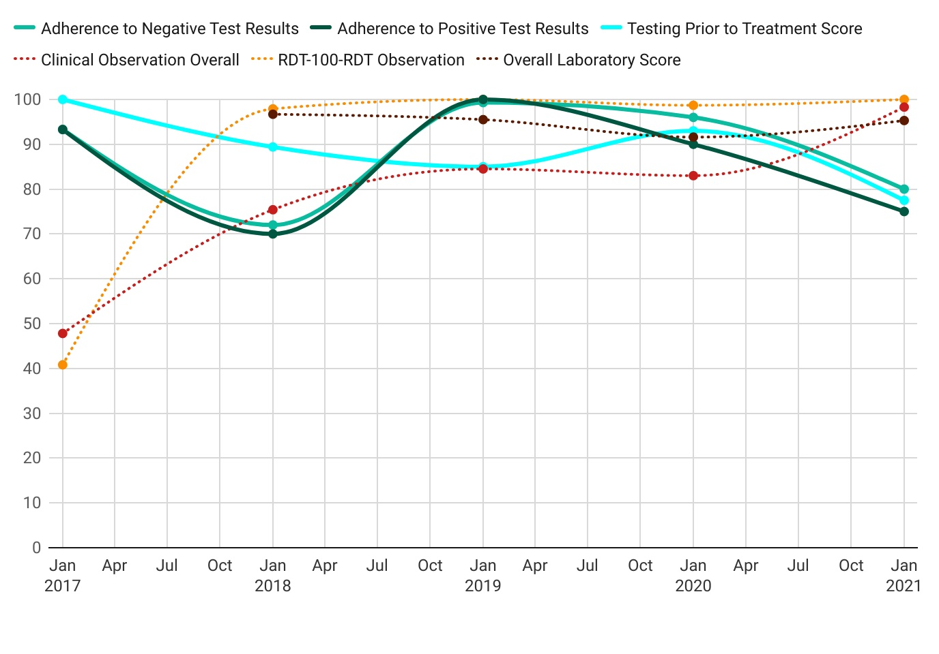
Nchelenge District Outreach Technical Supportive Supervision (OTSS) Score 2017 - 2021
Notes:
I would enumerate the six skills so that it is clear that they are components of the overall OTSS score.
Is there a reason why some lines are dotted and others not? Dotted lines seem to suggest lesser importance. Can you include the overall OTSS score as the clearest dark line that is now the “Adherence to positive test results”?

Slide 26
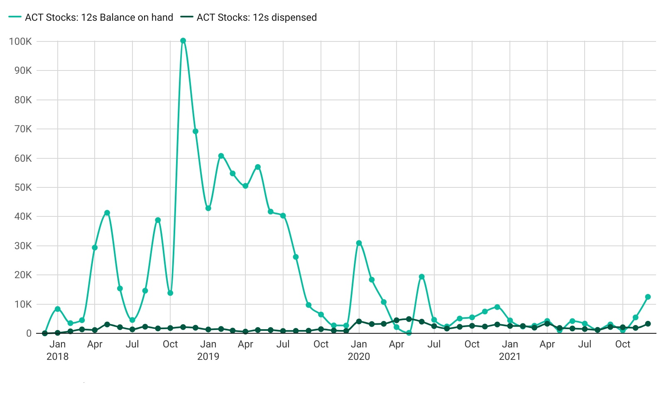
Nchelenge District Commodities Trends 2018-2021
Notes:
I have no idea what 12s are
Was there spoilage? Theft?
I would suggest presenting this section in an order that would put the inputs first, such as:
Availability of key commodities (I would also include the word availability in this title)
IRS coverage
OTSS score

Slide 27
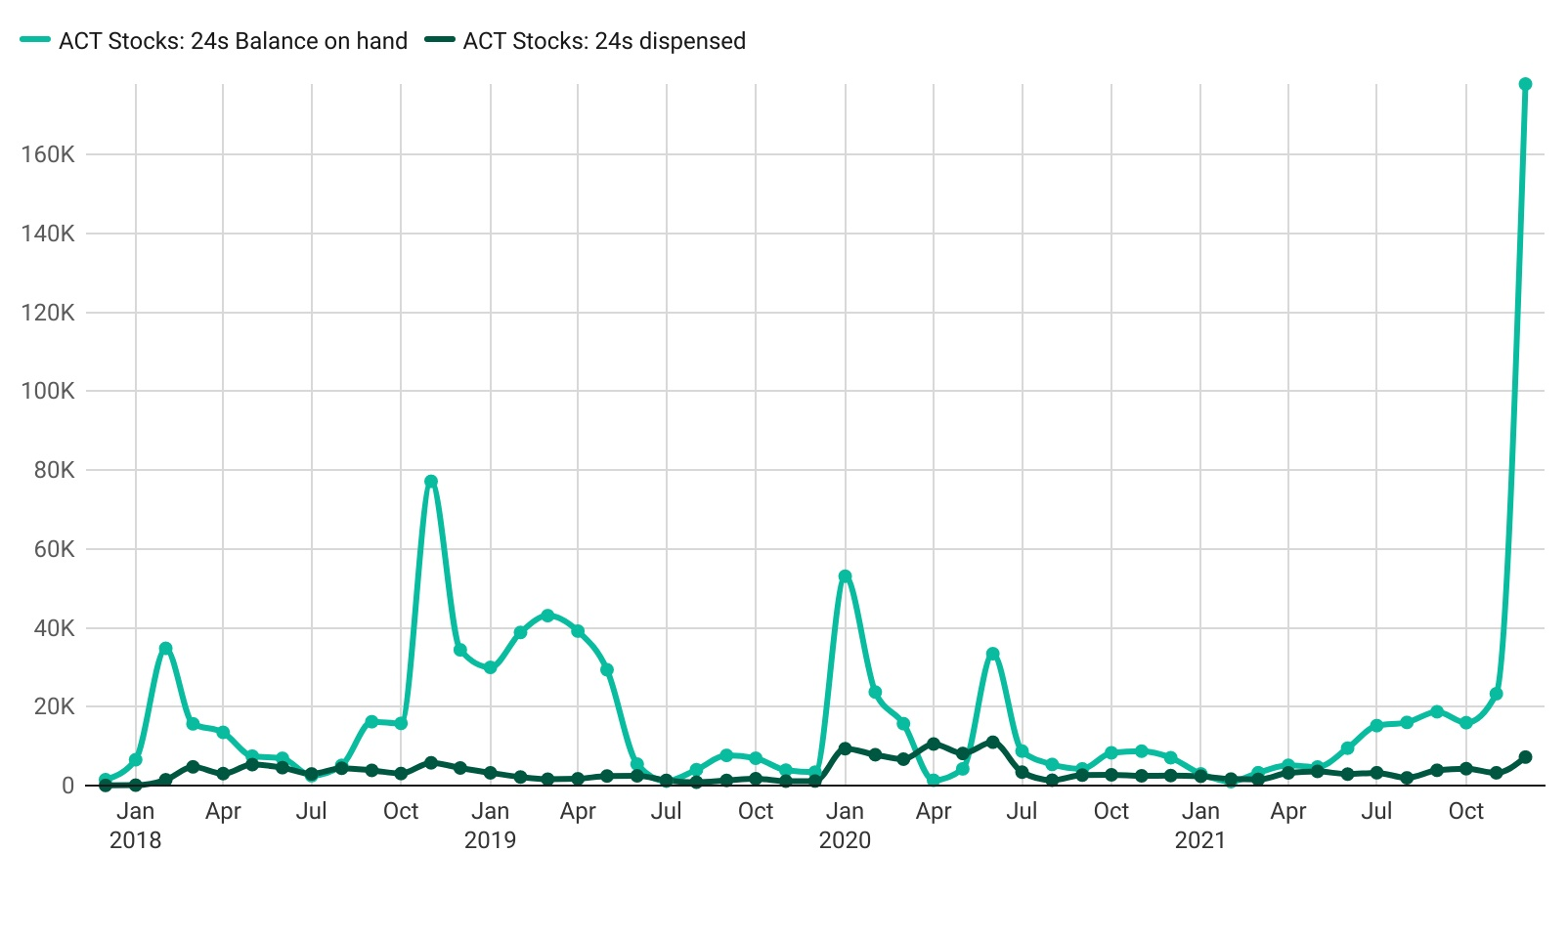
Nchelenge District Commodities Trends 2018-2021
Notes:
I have no idea what 24s are
Include the word “availability” in the title
Why was the stock so much higher in some months when the materials dispensed was fairly constant? Was there spoilage? Theft?

Slide 28
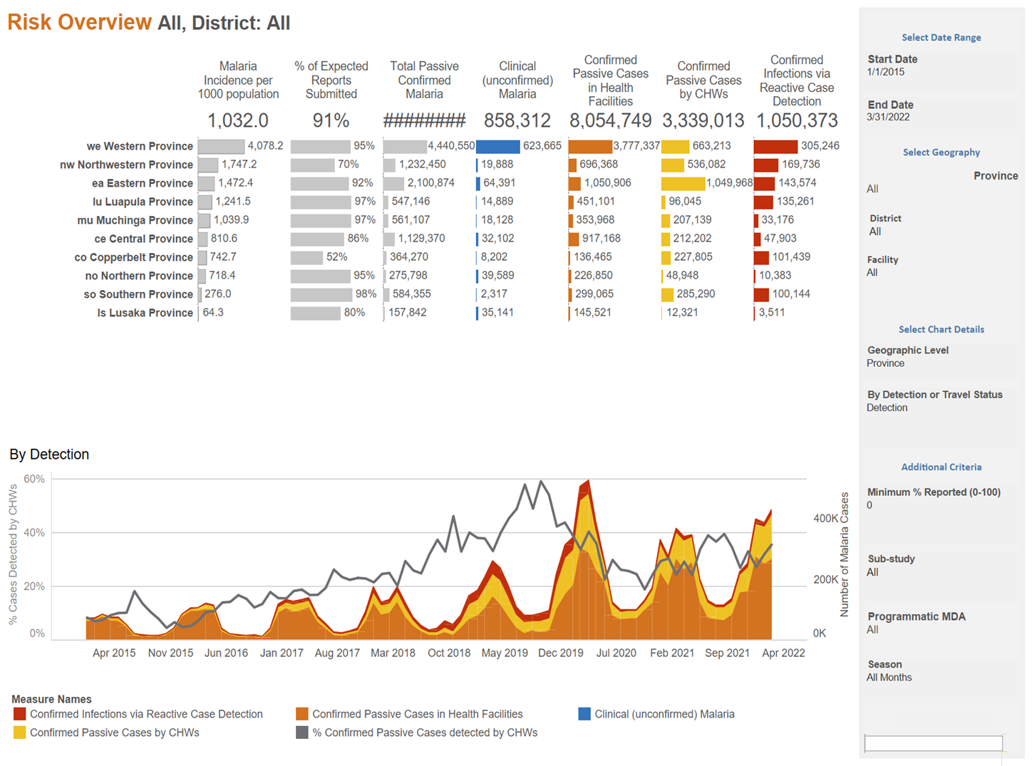




Slide 29
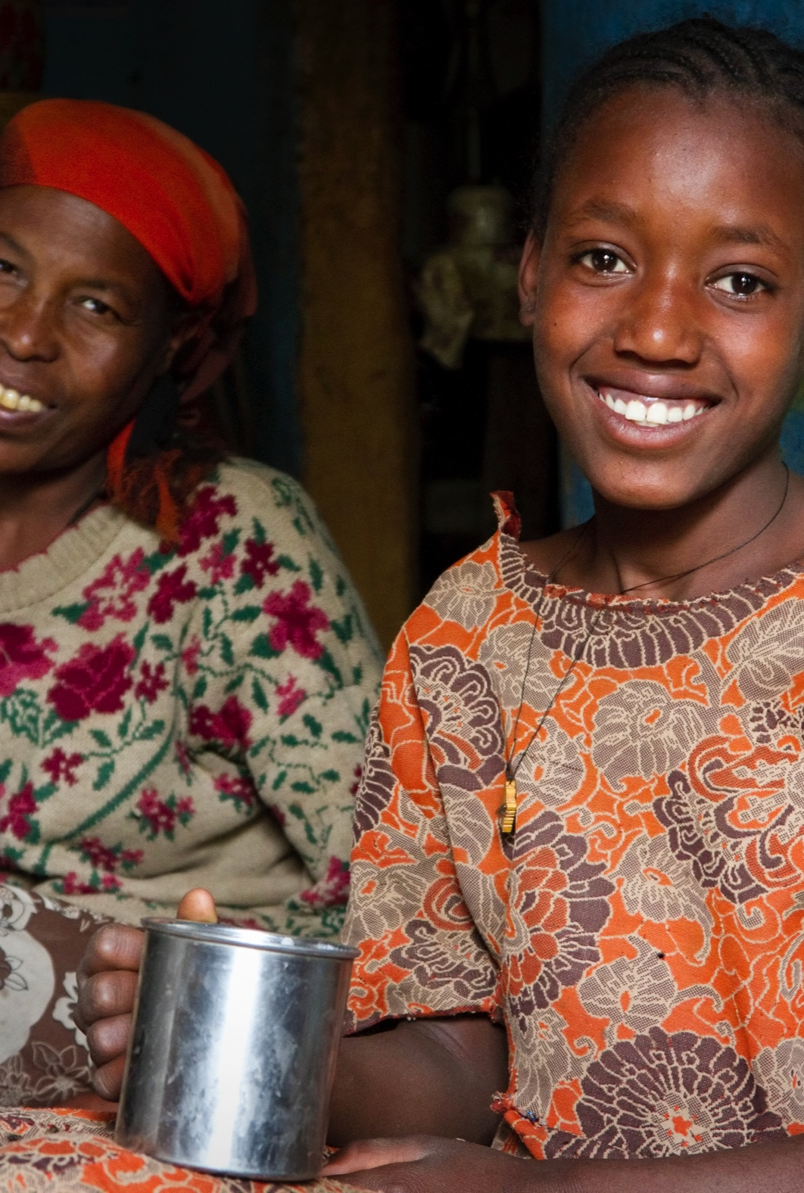
THANK YOU!
Contact Details:
USAID/Zambia COR: Arthur Kachemba
Email: akachemba@usaid.gov
E4H Chief of Party: Celia Tusiime
Email: ckakande@msi-inc.com
Senior Advisor Knowledge Management, Data Demand and Use: Gift Sitenge
Email: gsitenge@msi-inc.com

